Slide 1




Youtube Movie Recommendation Project
Presented by
Kishan Terdal
Rishikesh Thakker
Prasanna Chelliboyina
Het Trivedi

Slide 2
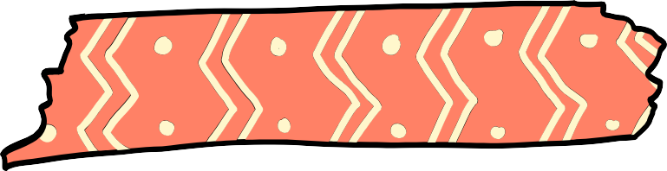



Introduction
Project objectives
This Project is aimed at creating Recommendation Systems for the MovieLens Dataset
Objectives
Using Collaborative Filtering and Deep Learning networks to create recommendation system for movies based on youtube videos

Slide 3
Stakeholders
Platform Users
Desire personalized recommendations aligned with interests while prioritizing privacy and data security to foster trust and engagement on the platform.
Advertisers
Seek opportunities to target relevant audiences through sponsored content, requiring metrics and insights to optimize advertising strategies and maximize user engagement.

Slide 4




MovieLens Dataset
Dataset consists of 100000 records which will be split in 80:20 ratio for training and test purposes
Ratings ranging from 1 to 5 were taken from 943 users on 1682 movies.
Data consists of
user ID, item ID, ratings, and timestamp

Slide 5
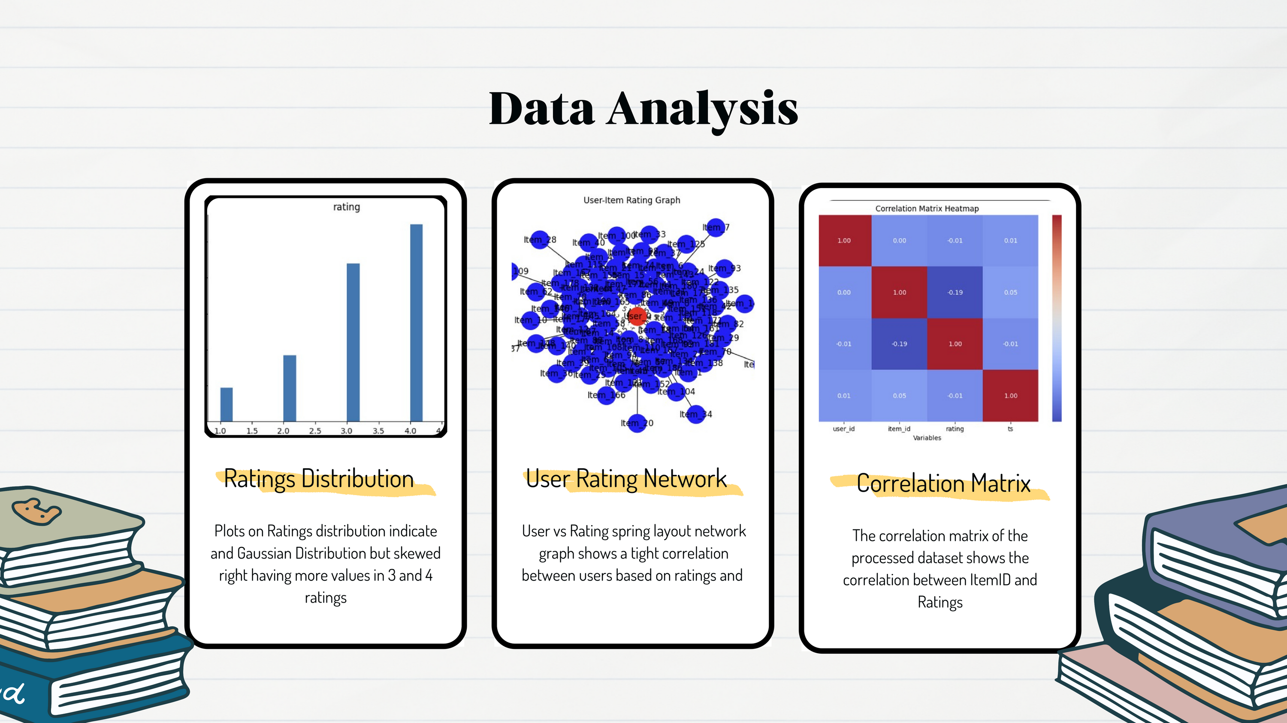

Slide 6

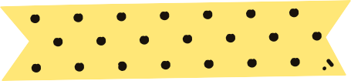
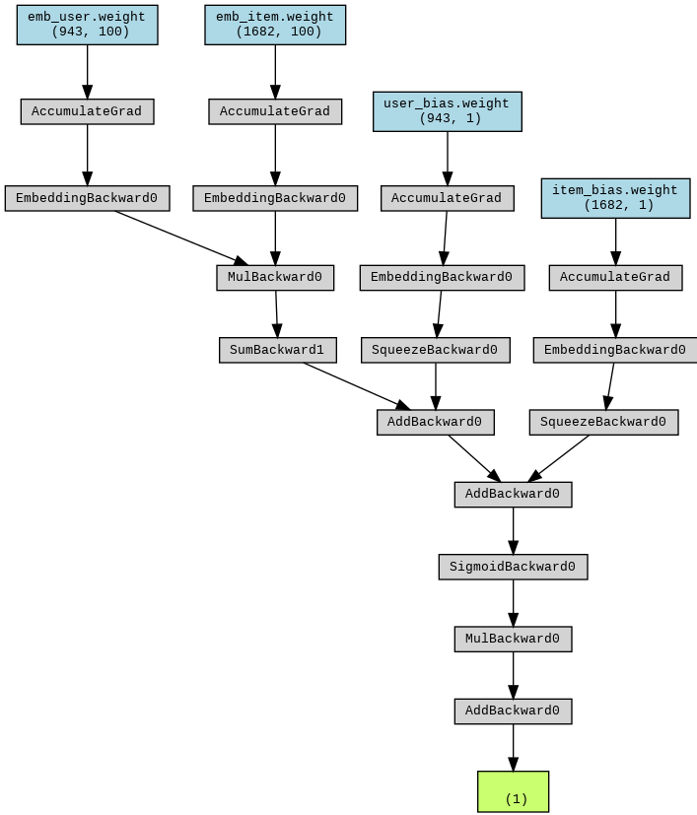
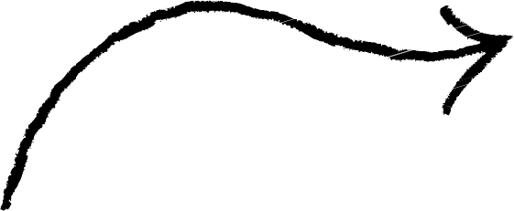
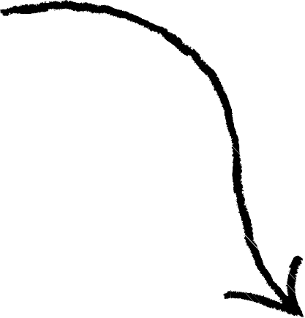
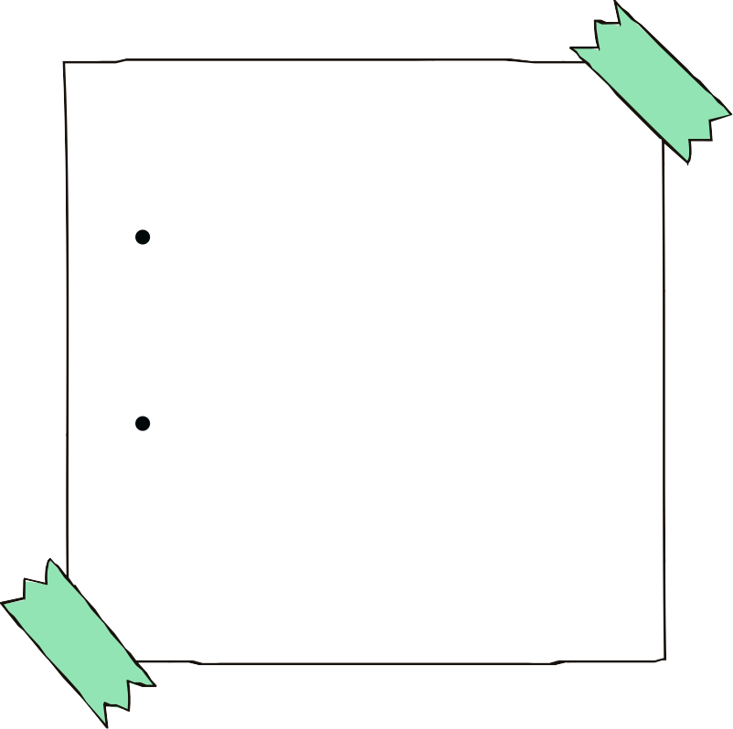
Model Summary : CollabNet
Model Structure
Embedding Layer Gradient Accumulation Bias Terms
Element wise Multiplication Dimension Reduction Sigmoid Activation
Inputs/Outputs
Input: The dimensions of these embeddings are (943, 100) and (1682, 100)
Output : A single predicted rating value per user-item pair

Slide 7
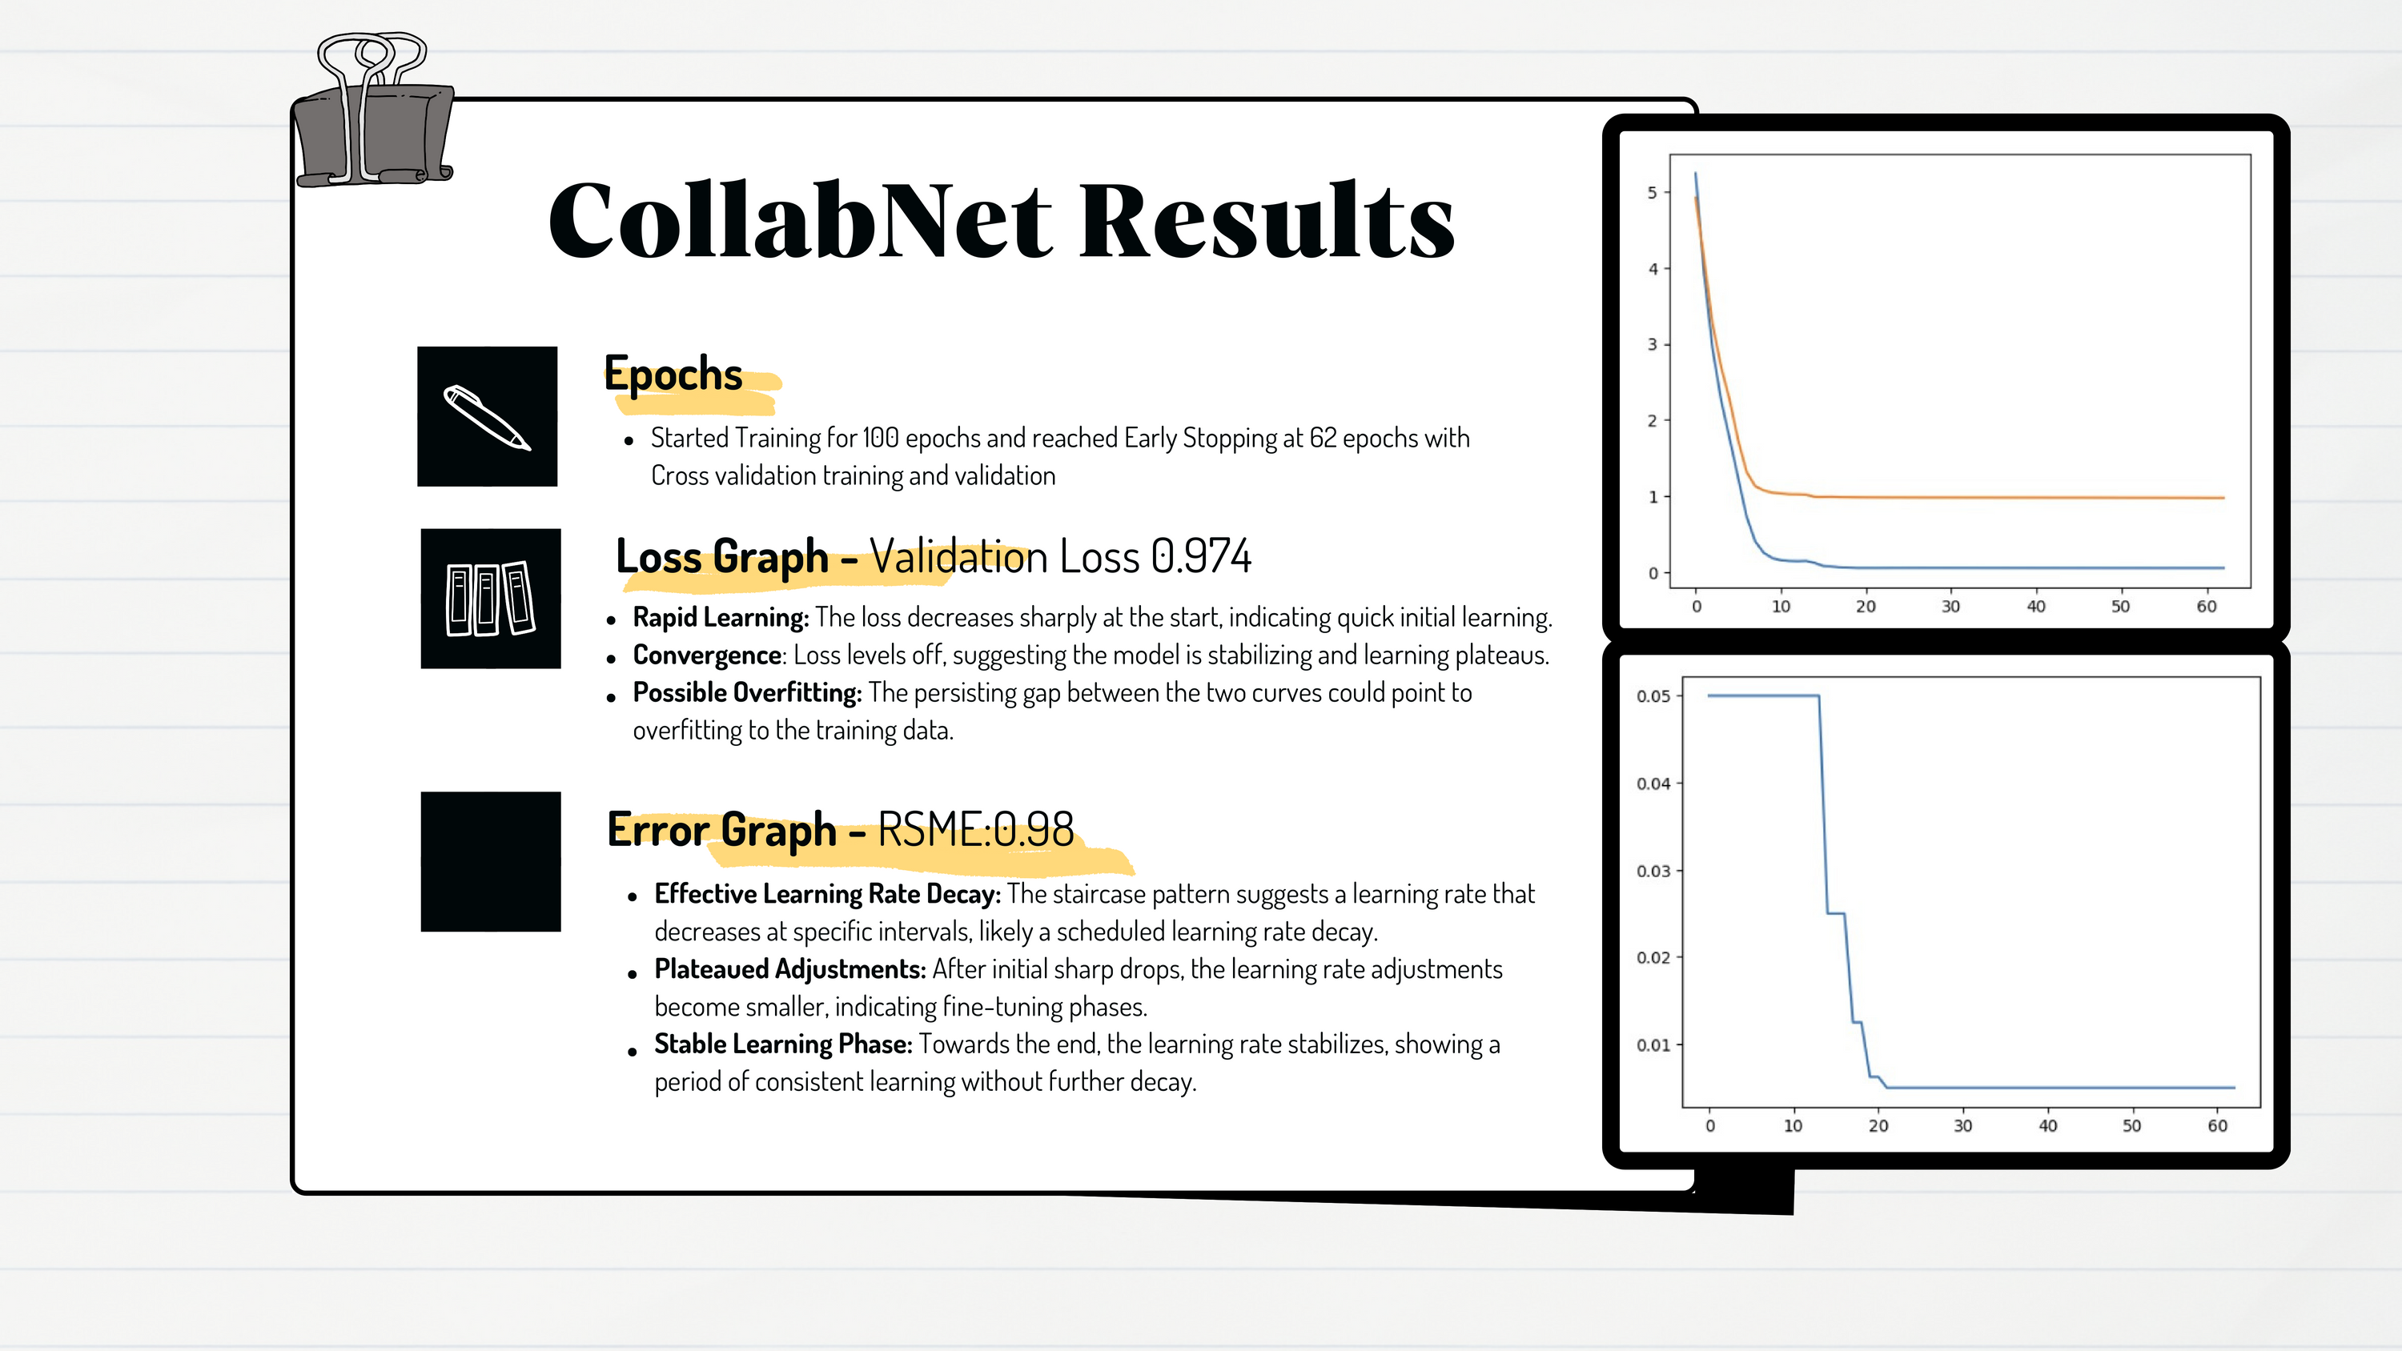

Slide 8

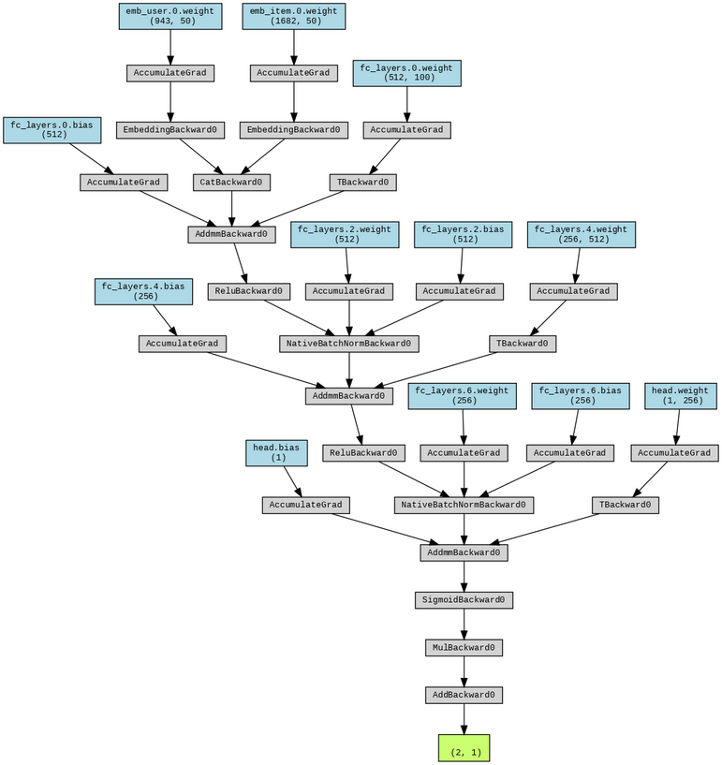
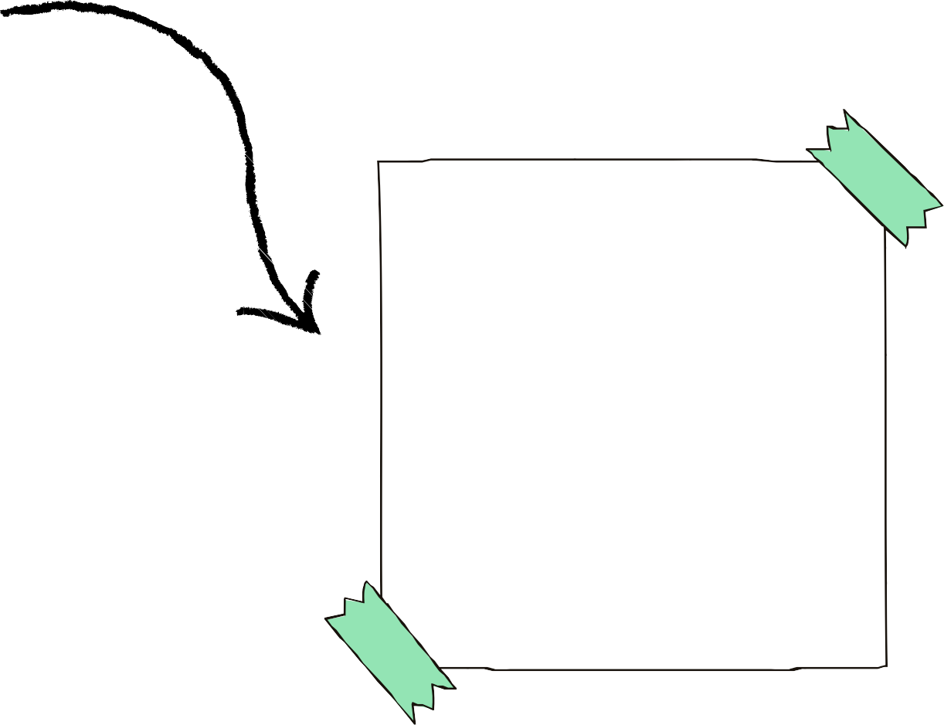
Model Summary : ConcatNet
Model Structure
Embedding Layer Gradient Accumulation Fully-Connected Layers Concatenation Layer Batch Normalization ReLU Activation Function
Inputs/Outputs
Input: The dimensions of these embeddings are (943, 100) and (1682, 100)
Output : A single predicted rating value per user-item pair

Slide 9
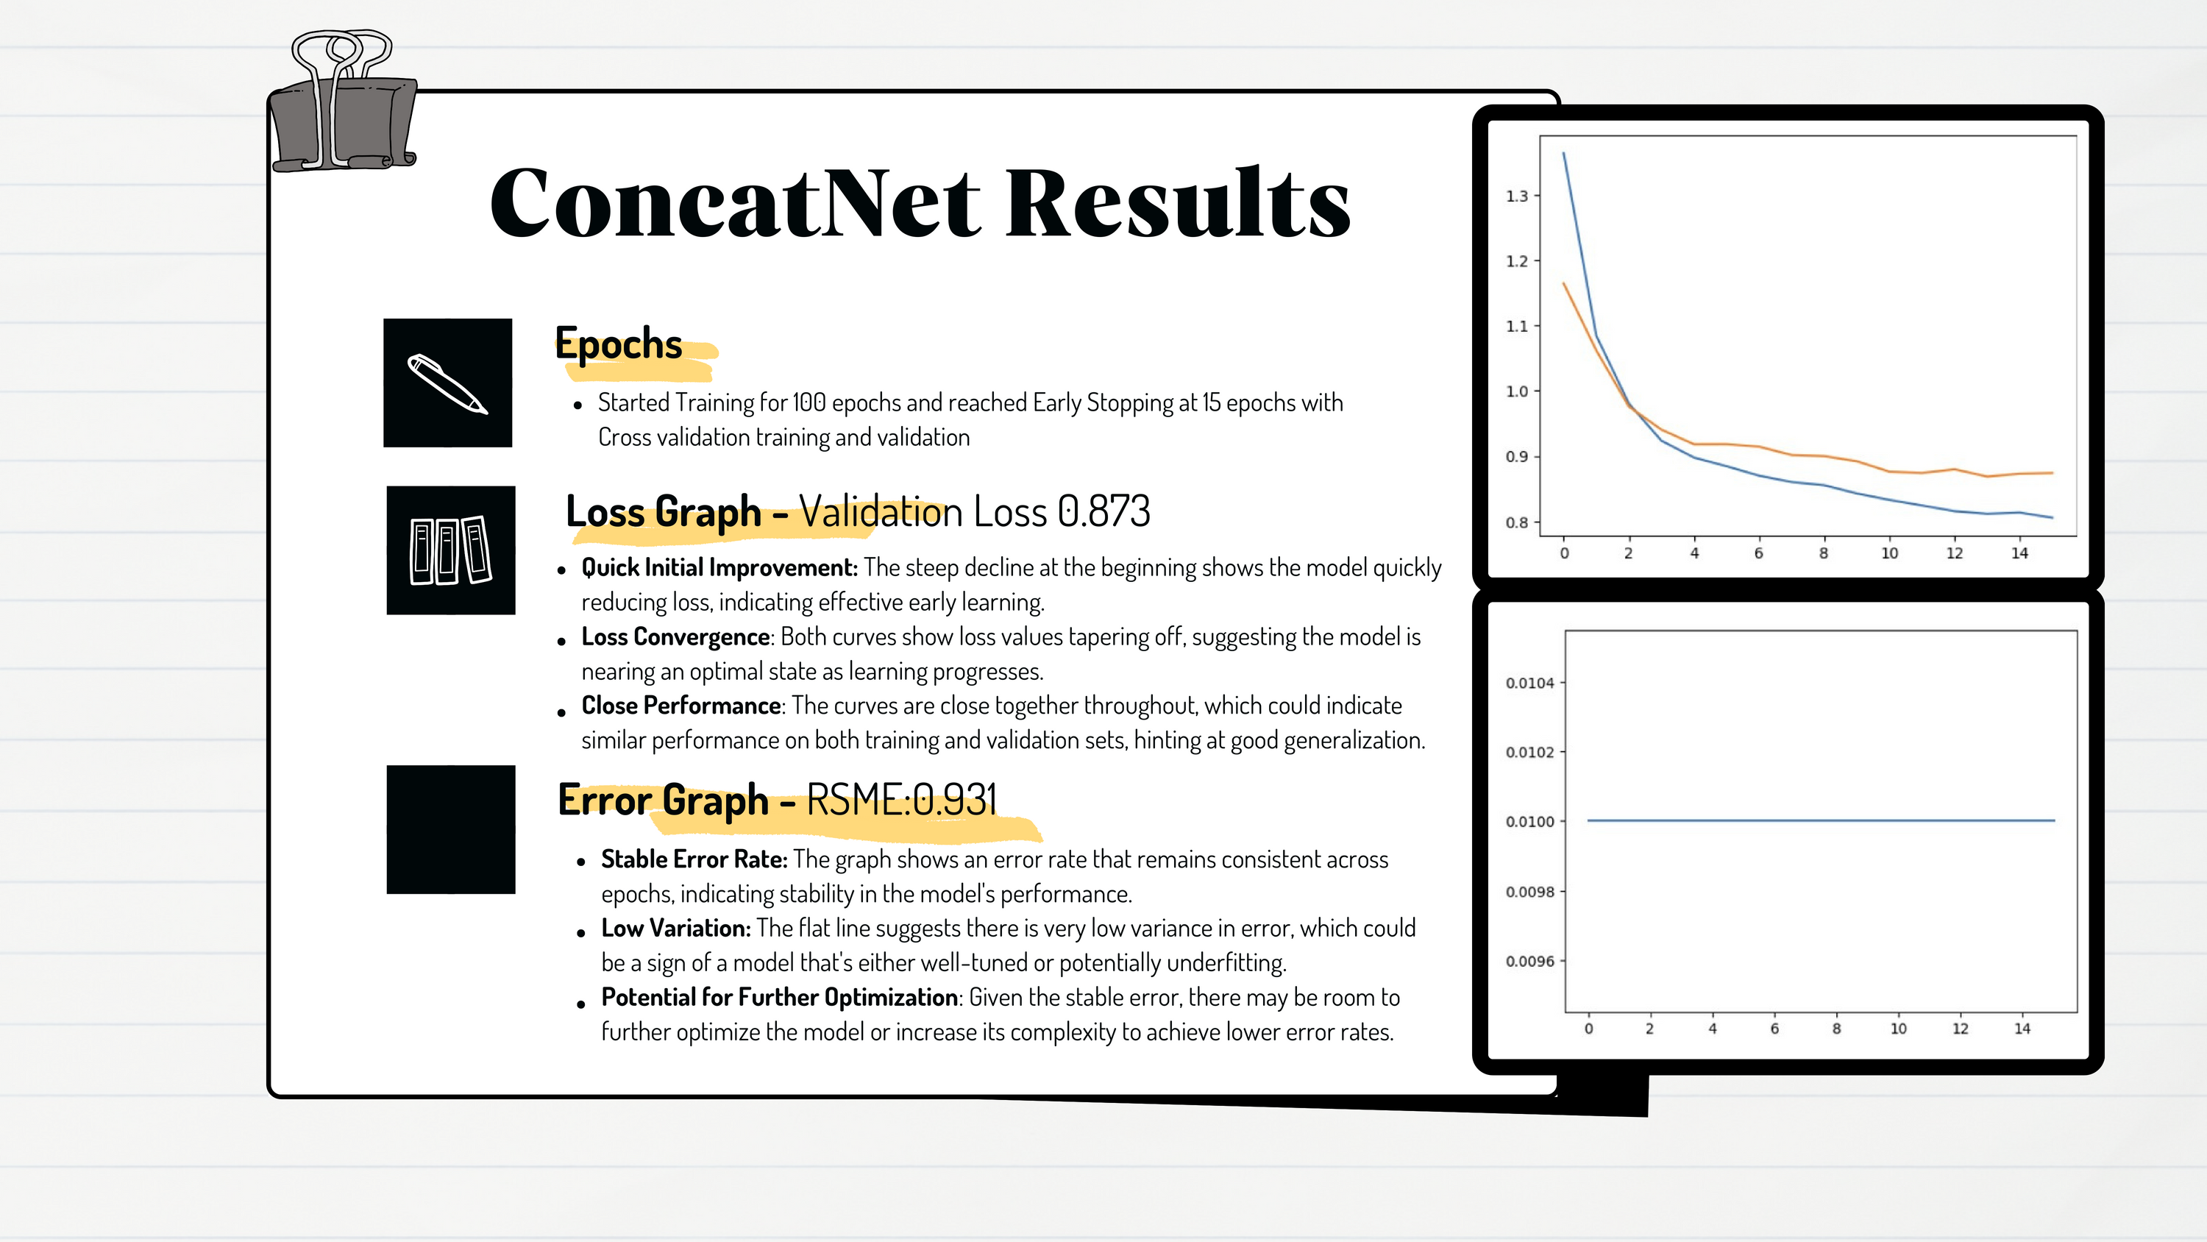

Slide 10

Comparitive Analysis
Validation Loss
CollabNet achieved a slightly higher validation loss (0.974) compared to ConcatNet (0.873), suggesting that ConcatNet may be fitting the data slightly better.
Both models showed good learning dynamics with rapid initial loss reduction followed by a plateau, indicating effective early learning and convergence.
Generalization
Learning Stability
The close tracking between training and validation loss in ConcatNet could be indicative of better generalization compared to CollabNet, where the gap suggests potential overfitting
Both models demonstrate stability over epochs. However, the error graph for ConcatNet shows a stable error rate over the epochs, hinting at a well-tuned model, potentially more so than CollabNet.

Slide 11
Limitations
Data Privacy and Security
Limited access to sensitive user data due to privacy concerns and regulatory restrictions may impact the depth of personalization achievable.
Algorithm Bias and Fairness
Inherent biases in the recommendation algorithms may lead to unfair or unequal treatment of certain user groups, requiring careful monitoring and mitigation strategies.
Scalability and Performance
Scaling the recommendation system to accommodate growing user and content volumes while maintaining performance may pose technical challenges.
Content Diversity
Limited diversity in available content may restrict the variety and relevance of recommendations, affecting user satisfaction and engagement.
Evaluation Metrics
Difficulty in objectively evaluating recommendation quality and user satisfaction may hinder accurate performance assessment and improvement efforts.

Slide 12





Conclusions
01
02
03
Overall, ConcatNet's lower validation loss and stable error rate suggest a more balanced model that generalizes well to unseen data without significant overfitting.
Despite good initial learning, CollabNet shows signs of overfitting, evidenced by the persistent gap between training and validation loss curves.
ConcatNet appears to be the more effective model in terms of both fit and generalization for the current dataset, but both models could benefit from further experimentation

Slide 13
Thank You Any Questions?

